Slide 1
Title: Predicting Housing Prices from Data
Author: Jason Lorenz

Slide 2
Introduction
Model: Linear_regression from sklearn (Ordinary least squared)
Steps of construction:
Analyze data to find variables with strong correlation to the sale price
Fit data to remove Null and prep for numerical analysis
Tested 3 models with R² as output metric
Tested final model against test dataset for positive result
*Please add slides as required.

Slide 3
The Data
Presented form: .csv file
Contained 100 example houses with 82 data columns for each
Initially ~20 numeric columns with more presented with categorical string data
Initial task was replacing high impact correlations with numerical data for inclusion into model calculation (See Data Preparation)
*Please add slides as required.

Slide 4
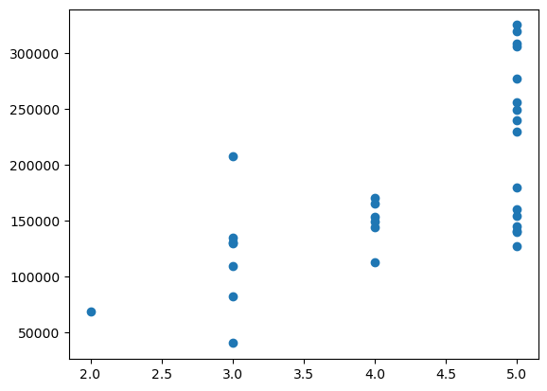
Data Exploration 1
HeatingQC – Heating Quality and Condition
Shows positive
correlation
*Please add slides as required.

Slide 5
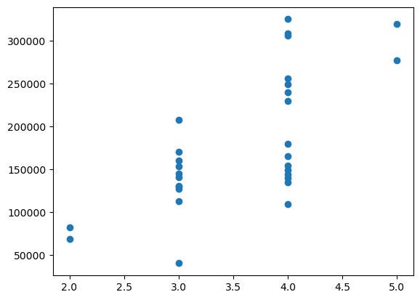
Data Exploration 2
KitchenQual – Kitchen Quality
Shows strong
positive correlation
*Please add slides as required.

Slide 6
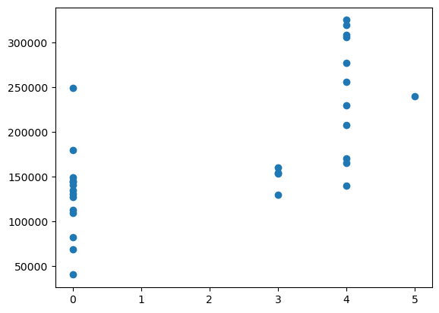
Data Exploration 3
FireplaceQu – Fireplace Quality
Shows general
positive correlation
*Please add slides as required.

Slide 7
Data Preparation
Cleaning data:
Replaced all null values with zeroes
If it was null the value likely did not exist which impacts the correlation
Converting categorical strings to numeric data
Used the data info file to gather types of categorical data and converted them to a numerical hierarchy for use in model construction
*Please add slides as required.

Slide 8
Correlation
Chose to add four new variables to model construction
Kitchen Quality
Heating Condition and Quality
Fireplace Quality
Garage Finish
Decided on these variables in the model because they had a correlation value of >0.60

Slide 9
Project Description
Chose the linear regression tool from sklearn (1)
Uses an ordinary least squared calculation model
Easily calculates multiple regression function using linear data with correlative data
Uses low computer resources so manipulation is efficient
*Please add slides as required.

Slide 10
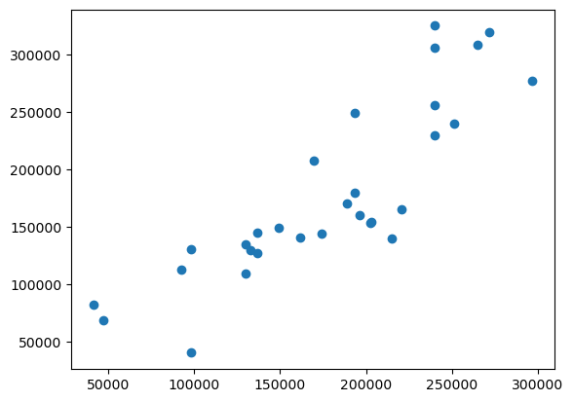
Analysis and Results
Model 1:
Variables used: SalePrice, HeatingQC, KitchenQual, FireplaceQu, GarageFinish
Results:
R²: 0.7304680472153073
*Please add slides as required.

Slide 11
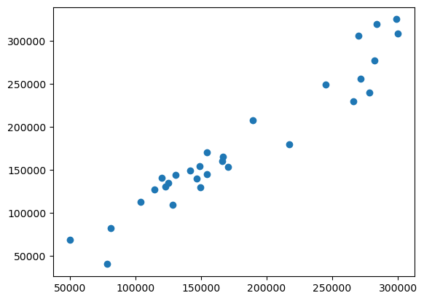
Analysis and Results
Model 2:
Variables used: YearRemodAdd, SalePrice, HeatingQC, OverallQual, GrLivArea, GarageArea, KitchenQual, GarageCars, YearBuilt, FireplaceQu, GarageFinish, 1stFlrSF
Results:
R²: 0.925783119360736
*Please add slides as required.

Slide 12
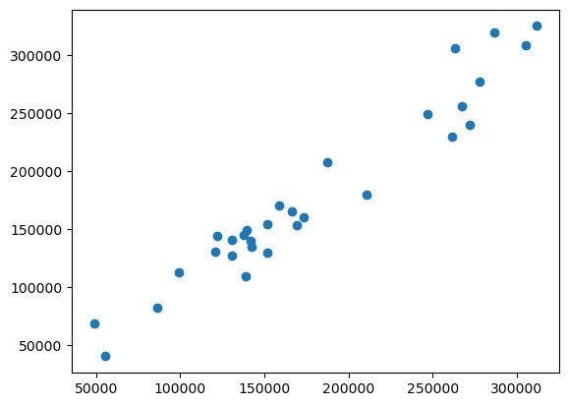
Analysis and Results
Model 3:
Variables used: YearRemodAdd, SalePrice, HeatingQC, OverallQual, GrLivArea, GarageArea, KitchenQual, GarageCars, YearBuilt, FireplaceQu, GarageFinish, 1stFlrSF, OverallCond, EnclosedPorch
Results:
R²: 0.9391234422685611
*Please add slides as required.

Slide 13
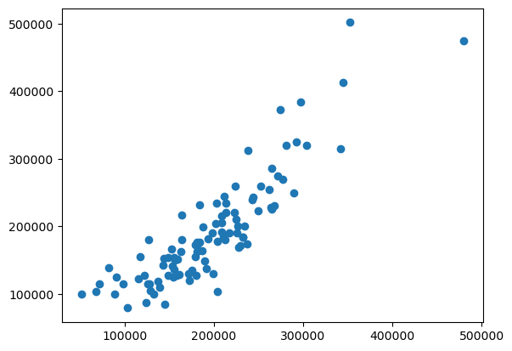
Verification
Test Results:
R²: 0.764784957988108
Scatter plot shows positive upward trend when prediction is plotted vs actual sale price
*Please add slides as required.

Slide 14
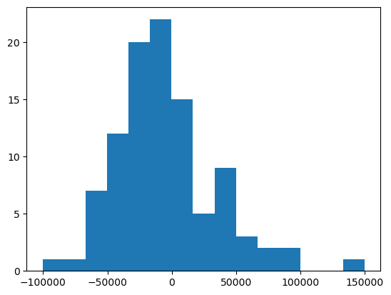
Verification
Histogram of the differences in sale price show a normal curve
This follows the standard error of a regression model
Supports that my model can reliably predict housing prices within $50k
*Please add slides as required.

Slide 15
Conclusion
Successfully built model to predict housing prices using the linear regression tool in sklearn
Used 14 variables from teaching data to build model
Validated with R² and histogram of prediction error
Learning points from this project
Helped me understand how to build a simple linear regression model from a small set of teaching data
The importance of using previous knowledge like the use of matplotlib.pyplot to verify other outputs from numerically functioning code
*Please add slides as required.

Slide 16
References
(1) No Author "Ordinary least squares." Wikipedia. Wikimedia Foundation, 2023, January 26. https://en.wikipedia.org/wiki/Ordinary_least_squares#
*Please add slides as required.

